Slide 1
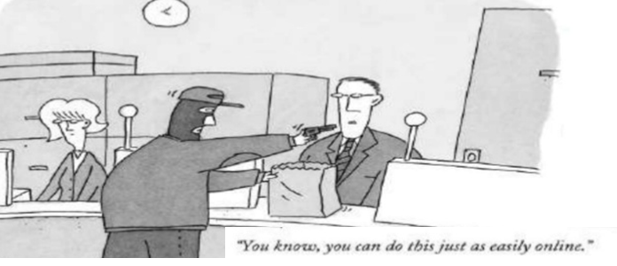

Automated Security Testing

Slide 2

Agenda
What is Security Testing ?
Why we Testers need to worry about it ?
Why Automated Security Testing?
How can we Automate this?
Demo
Resources

Slide 3

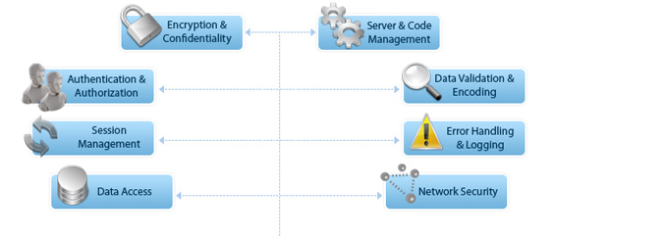
What is security Testing
Part of Software Testing
Process intended to reveal flaws in the security mechanism.

Slide 4

I am not a security tester !
Why do we, Testers need to worry about security testing ? Isn’t there a Security Team to handle this ?
Tester = { Functional testing + Non Functional
(Performance, Security..)}

Slide 5
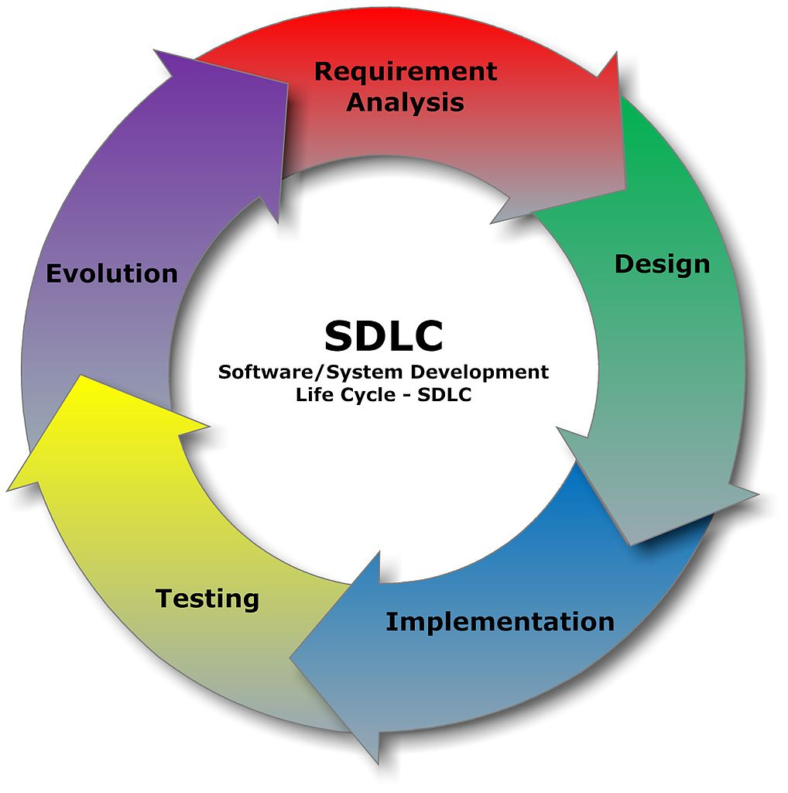
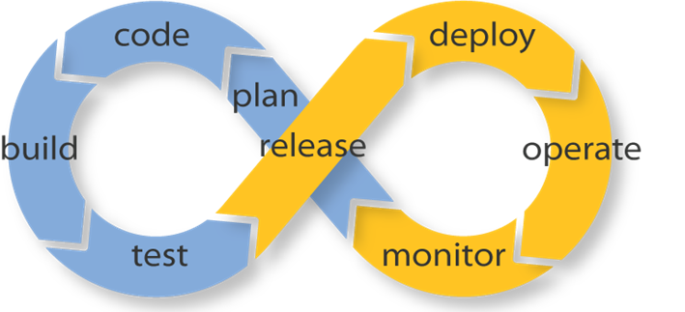
Why Automated security testing?

Slide 6

Detect known vulnerabilities early in the cycle
Reduce Costs – Amount of time you need to hire Security professional
10 min to get you started with your first Attack proxy and scan
Can use your existing automated functional tests to generate HTTP traffic, no need to write special security tests.

Slide 7
WHERE ARE WE ? As on 2014

Slide 8
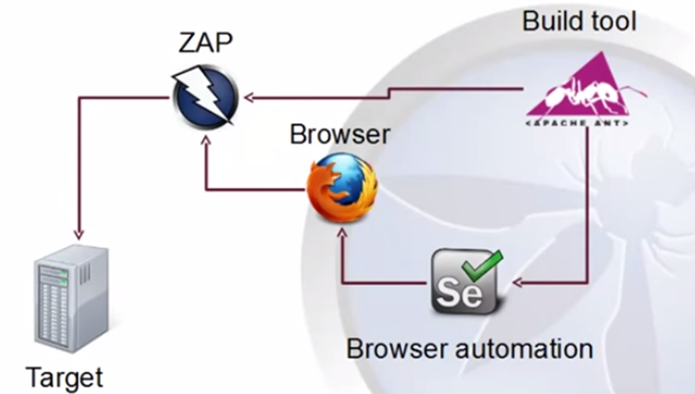
How did we do? “Attack Proxies”
Sit between Target and Tester
- Search for http traffic patterns
- Manipulate headers
- Scan for vulnerabilities
- Fuzzing

Slide 9

Always Remember
Never run any Security Tests on sites that you
aren’t authorised to do so.

Slide 10

in Action…

Slide 11
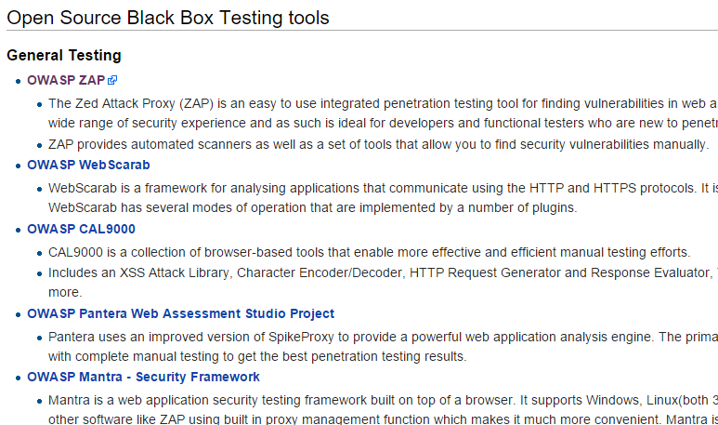
Resources – So many options to explore!
https://www.owasp.org/index.php/Appendix_A:_Testing_Tools

Slide 12
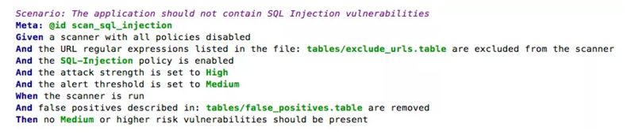
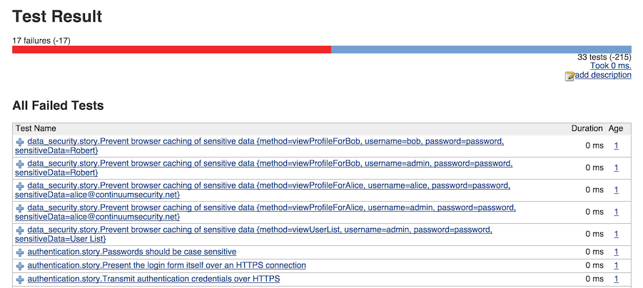
BDD in Security testing. Is it possible?

Slide 13
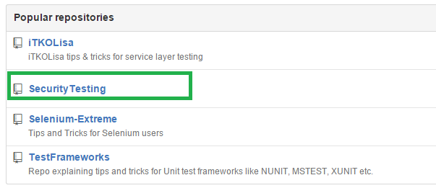
On GITHUB
https://github.com/impeccable-tester/SecurityTesting

Slide 14


I am now a security tester ☺

